Slide 1
GP CPCS General Practice referral pathway to the NHS Community Pharmacy Consultation Service PCN INTRODUCTION

Slide 2
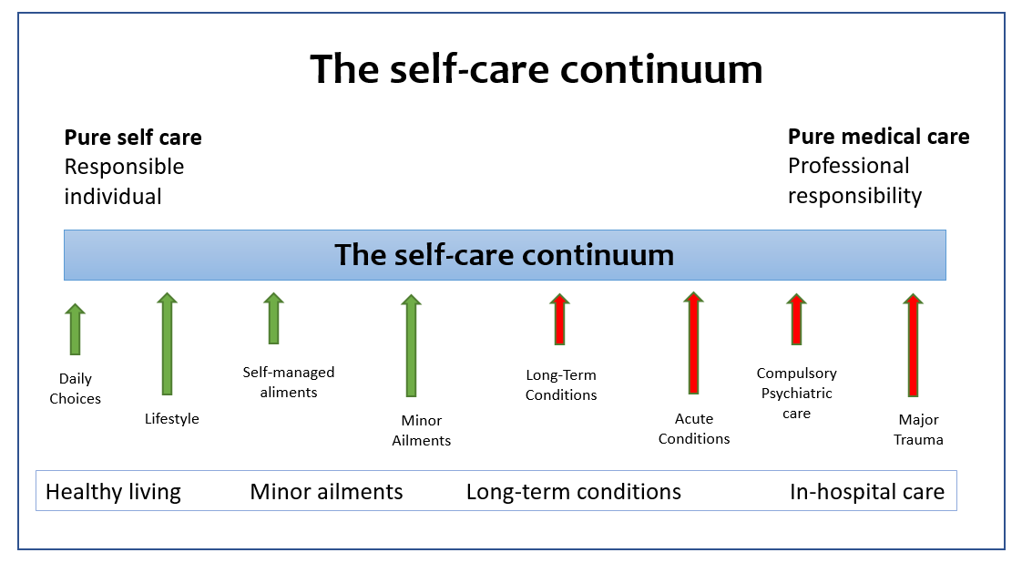
Common Ailments and Self-care

Slide 3
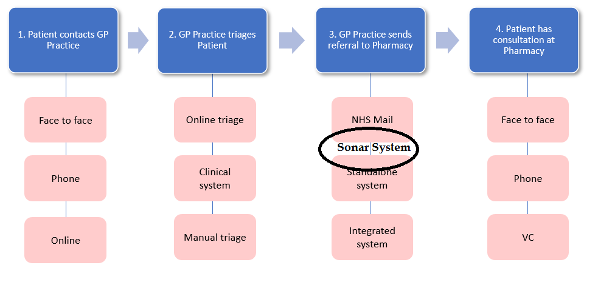
GPCPCS Patient Journey

Slide 4
What is GP CPCS? General Practice referral pathway to the NHS Community Pharmacy Consultation Service
Safe Monitored pathway
2019 via NHS 111 & 111-online
GP CPCS –Is now a National NHS Service.
Refer Minor illness to Pharmacy
(Common Ailments )
A Structured Consultation- record made and shared with GP
AIM – To resolve patient issue & improve self care
Escalation If and when required
Patient feedback – can refine & improve service
Detailed Reports for GPs on Sonar Platform
More GP appointment time for patients with complex needs
Integrate Pharmacy as part of your team
( GP – Pharmacy working closer for better outcomes)

Slide 5
GP and Pharmacy PCN - GPCPCS set up process
PCN stakeholders determine how to implement the referral pathway, strong relationships between Pharmacy and GP practice colleagues.
Prep work required and exchange of formal launch dates and a PCN wide approach.
Clinical Governance -Community Pharmacy PCN lead , PCN clinical lead to exchange and agree a process.
Set up Start date 1-2 weeks. Training for all GP staff on conditions / use of Sonar platform.
Check list

Slide 6
Checklist to start process
Referral method operational: reception staff have the appropriate training and feel competent to make referrals.
Process for monitoring arrangements for referrals and gathering staff/patient feedback including handling of any incidents.
Patient communication made available advising about referral pathway (practice digital screens, answer phone, website, social media etc.
Post-event message (PEM) process (from pharmacy to practice). Practice staff aware of process to manage PEMs received from community pharmacy.
Contact details shared with agreed process for notifying the practice of “ Urgent Referral Back to GP” +Any changes to Service .Healthcare professional telephones, and email addresses, shared with both the practice and pharmacy- GP Bypass Phone Number.
Agree a ‘go-live’ date when the practice will be ready to make referrals and communicate this to regional implementation lead(s).Sonar to offer training to all GP staff - Access to Sonar and Introduction to Conditions for GPCPCS Referral .

Slide 7
Words Matter
Terms and wording - Important - words can be interpreted differently!
“We are referring you for a personal consultation to a NHS service”
“I am sending you for a same day appointment with an NHS community pharmacist for a personal consultation”
“Once the pharmacist has received the referral, they will contact you by phone in a timely manner”
This is NOT a Sign posting service - Formal Electronic referral (similar to a X -ray , Blood tests etc. Patient will be seen, and a record made which can be shared back to the GP if required)
Suggested script for reception teams/care navigators to use on initial phone calls with patients (word Doc - in system )

Slide 8
GP CPCS – Medical Conditions allowed for referral
50+ Medical Conditions
Acne, Spots and Pimples
Arm, Pain or Swelling
Blisters
Cough
Earache
Eye, Sticky or Watery
Failed Contraception
Headache
Itch
Lower Back Pain
Nasal Congestion
Scabies
Sleep Difficulties
Tiredness (Fatigue)
Wound Problems
Allergic Reaction
Athlete's Foot
Cold or Flu
Diarrhea
Eye, Painful
Eye, Visual Loss or Disturbance
Hair loss
Hearing Problems or Blocked Ear
Knee or Lower Leg Pain or Swelling
Lower Limb Pain or Swelling
Pain and/or Frequency Passing Urine
Shoulder Pain
Sore Throat and Hoarse Voice
Toe Pain or Swelling
Wrist, Hand or Finger Pain or Swelling
Ankle or Foot Pain or Swelling
Bites or Stings , Insect or spider
Constipation
Ear Discharge or Ear Wax
Eye, Red or Irritable
Eyelid Problems
Head Lice
Hip, Thigh or Buttock Pain or Swelling
Limb, cold or color change
Mouth Ulcers
Rectal Pain, Swelling, Lump or Itch
Skin, Rash
Tattoos, Birthmarks or Moles
Vomiting

Slide 9
GP CPCS - Overview
Community Pharmacy Consultation service
GP Staff Training
GP Panel
Pharmacy Panel
Complete structured consultation.
Where appropriatePatient notification will be sent to the GP via ITK or @nhs.net email
Training materials online Charts & webinars Medical conditions
IT system training
GP Team sends a referral to the pharmacy
Listed Common Ailments
Patient Feedback Via text or emails
Feedback form will be sent to the patient once the GP CPCS consultation has been completed

Slide 10
GP CPCS – Training
Training to be provided to all reception staff and others via webinar (Recorded webinar available to be viewed anytime) to understand conditions and the use of the Sonar GPCPCS materials and the IT system.
No additional Costs to GP or PCN for GPCPCS ( Integration funding may be applied for with PCN support).
Easy to use flip charts to be available on reception counter, with medical conditions which can and cannot be referred to the pharmacies.
Condition | Can Refer to Pharmacy | Can not Refer to Pharmacy
Condition A | Symptom 1, Symptom 2 | Symptom 3, Symptom 4

Slide 11
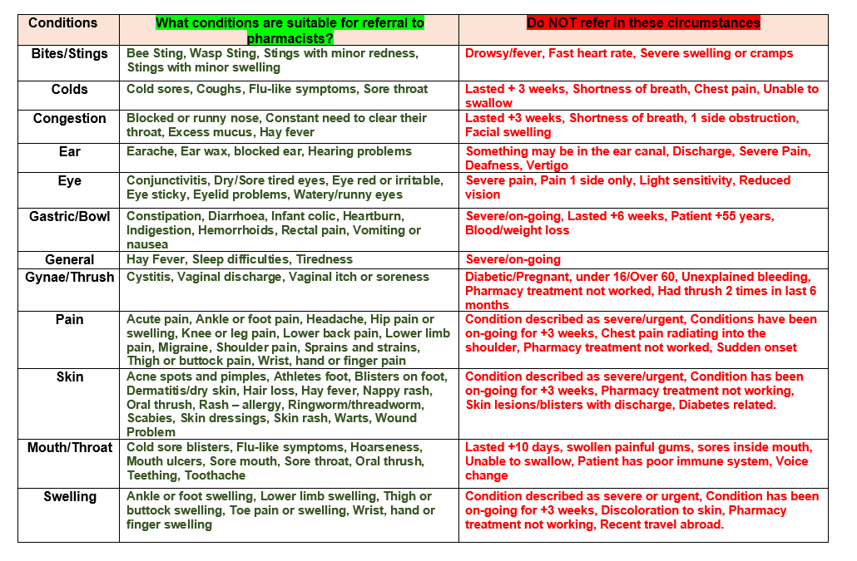
GP CPCS – Conditions to Refer Pharmacy

Slide 12
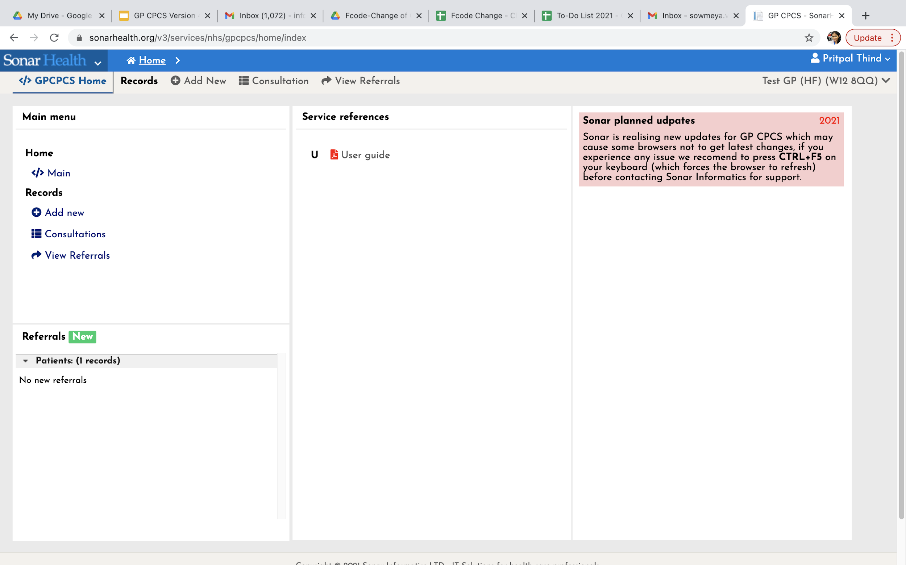
Login to go to GP CPCS – Home Page
Add New” to enter the patient details.

Slide 13
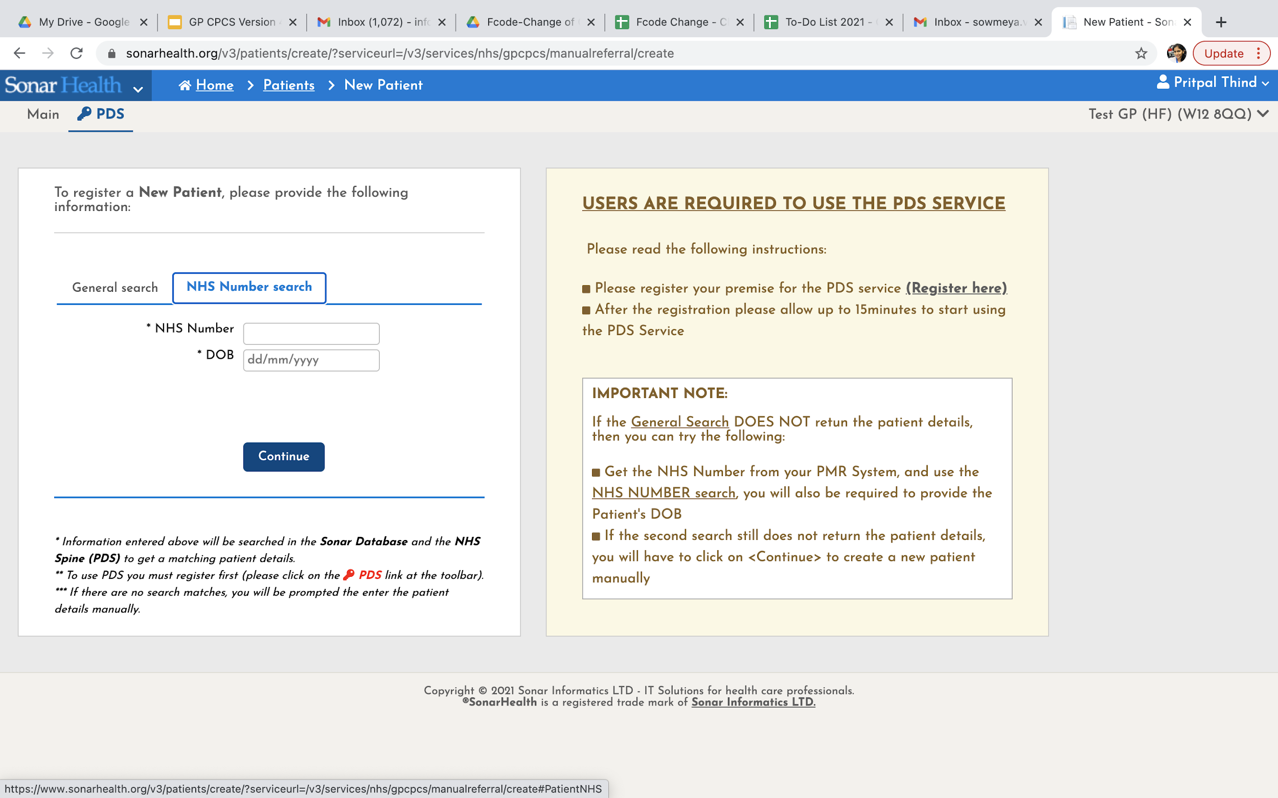
GP CPCS – Add a new Patient
NHS number and DOB
Or
“General Search” First name, Surname, DOB and Gender

Slide 14
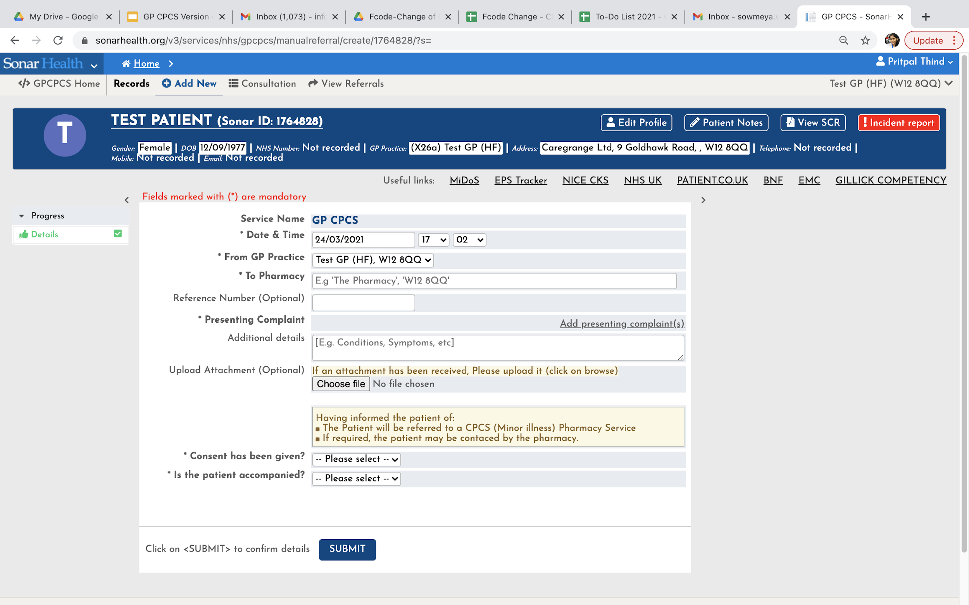
GP CPCS – Enter Patient Details
1. Choose Pharmacy ( Patient Choice only)
2. Select presenting complaint(s)
3. Patient Consent

Slide 15
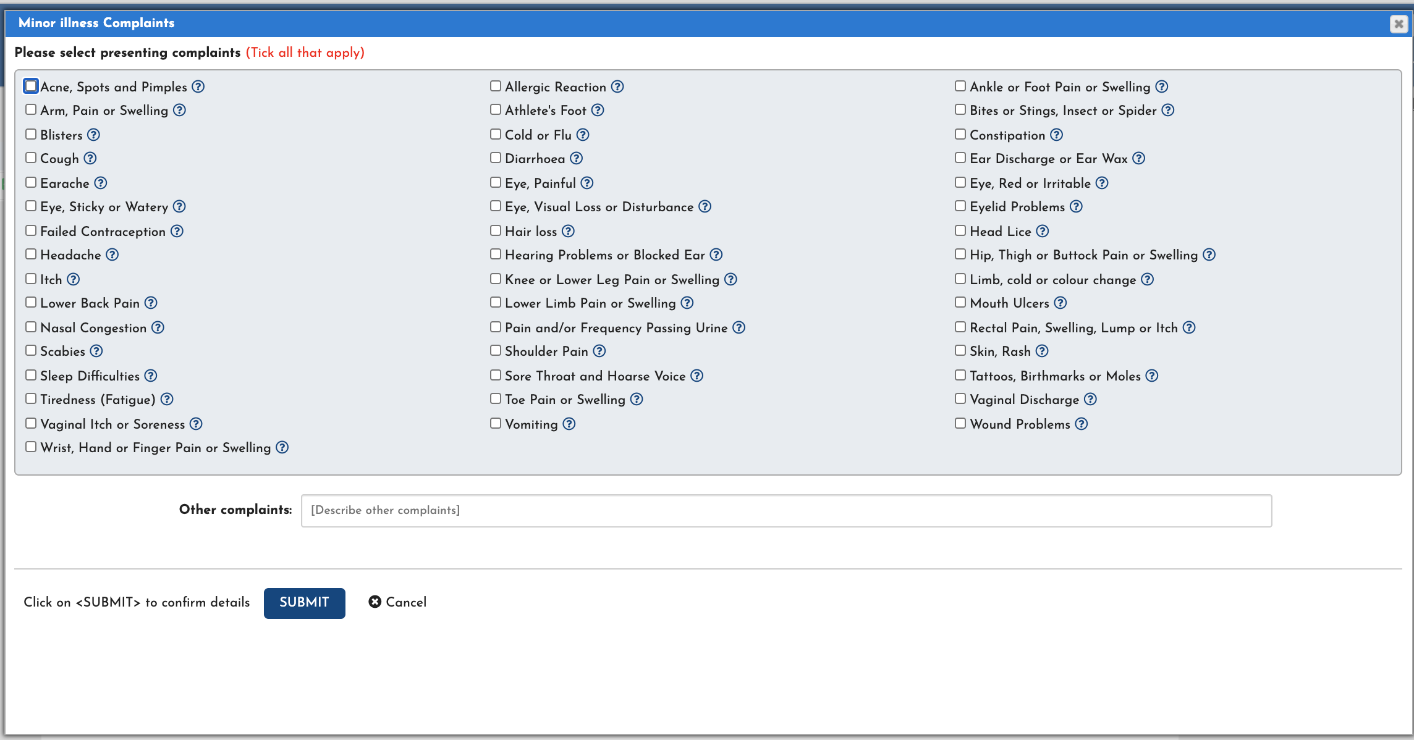
GP CPCS – Select Medical Conditions

Slide 16
GP CPCS – New Referral created
Record status will change As Patient goes through Process

Slide 17
GP CPCS – View Referral
To view the patient record once created, select the patient record and click “View Referral”.

Slide 18
In summary
“I am sending you for a same day appointment with an NHS community pharmacist for a personal consultation”
GP sends a CPCS referral –
Pharmacy completes a structured consultation on Sonar system - feedback to GP where required
The Pharmacy
Pharmacist to review patient symptoms for referral, history, existing condition, current medication , onset and duration , other factors
View SCR – summary care record ( current and discontinued medication, Current Confirmed allergies, plus optional others information -Vaccinations etc.)
Review NICE – CKS clinical knowledge summaries -Review Red Flags
90% of patient - episode is resolved and closed.
Sonar System
PDS - Confirm patient ID using PDS ( Patient demographics service - Picks up Tel No , email)
ITK -All records sent to GP system via @nhs.net
Direct Access -to Sonar as for flu. Log-in and retrieve reports and records anytime

Slide 19
Thank You
Pritpal.thind@sonarinformatics.com
9 Goldhawk Road
London W12 8QQ
0208 811 2307
07783937021

